Slide 1
MyInvoice
Michelle L. Wilson
DFAS Columbus
Customer Care Office

Slide 2
MyInvoice
Web-based application developed specifically for vendors and government users to obtain status of vendor’s invoices
Requires PIEE (Procurement Integrated Enterprise Environment) WAWF registration with at least one active role to access the myInvoice web application
Consolidates invoice information, paid and unpaid, as provided by numerous DFAS payment systems, into a central repository
Users may query and view data, and also download information for further analysis

Slide 3
MyInvoice - Benefits
Contractor/vendor and Government/Military entities may utilize myInvoice to:
Research the status of recently submitted and processed invoices.
Determine when payment is scheduled.
Determine if something is lacking for payment processing.
Obtain information associated with an Electronic Funds Transfer (EFT) or check received.
Determine the applicable payment office/processing site.
Research status based on Contract number; invoices covered; interest or freight included in the payment; or tax or discount withheld.
Reduce the need to call Customer Care for invoice status.
Invoice must be received at the DFAS pay office in order for there to be any invoice status.

Slide 4
Pay DoDAAC that update invoice status in MyInvoice
CAPS-W Pay DoDAAC : HQ0131, HQ0303, HQ0304, HQ0105, HQ0347, HQ0302, M67443, HQ0431, HQ0301, HQ0300, HQ0104
DAI Pay DoDAAC : HQ0492, HQ0624, HQ0690, HQ0748, HQ0750, HQ0751, HQ0650, HQ0684
DEAMS Pay DoDAAC : F87700
EBS Pay DoDAAC : SL4701
FABS Pay DoDAAC : HQ0252
FAMIS Pay DoDAAC: HQ0810
GFEBS Pay DoDAAC : HQ0490
IAPS Pay DoDAAC : F03000, F67100, F78900
MOCAS Pay DoDAAC : HQ0337, HQ0338, HQ0339
MOCAS Interest Payments
Navy ERP/STARS-One Pay: Pay DoDAAC starting with an “N”
SAVES: Standard Automated Voucher Examination System

Slide 5
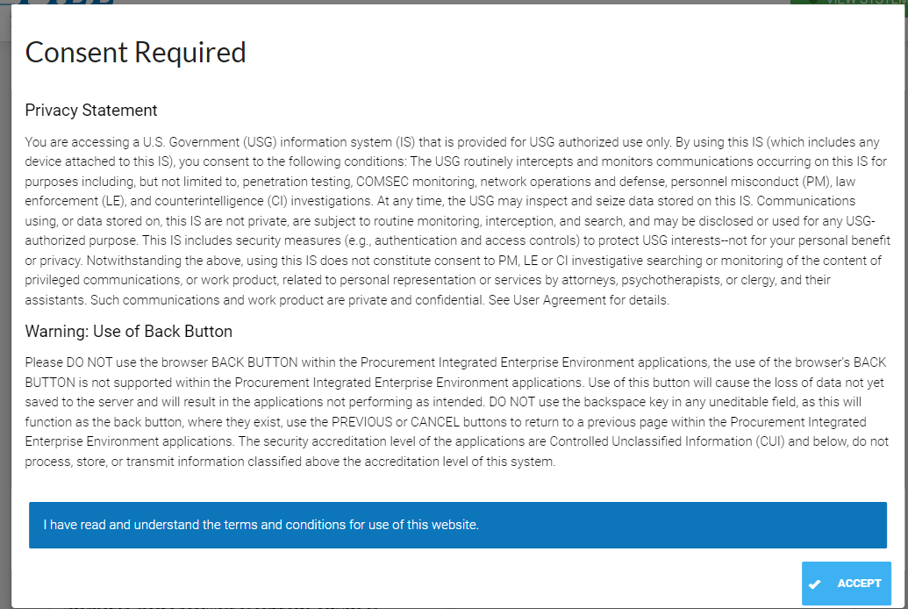
MyInvoice
https://piee.eb.mil/
This is the first screen you come to when you first log in.
Click Accept

Slide 6
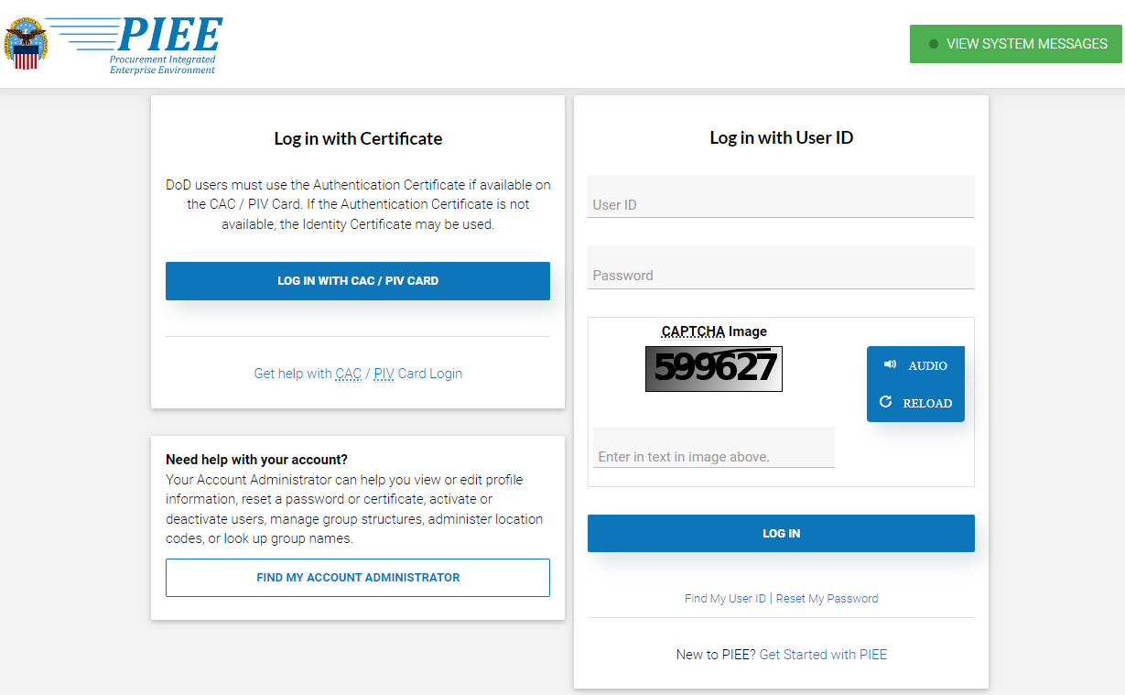
MyInvoice
If you are not a registered user for PIEEF, click on New to PIEE? Get Started with PIEE ; complete the required information.
If you are a registered government user, click on Log in with CAC/PIV Card.
If you are a registered vendor user, input your User ID and password.

Slide 7
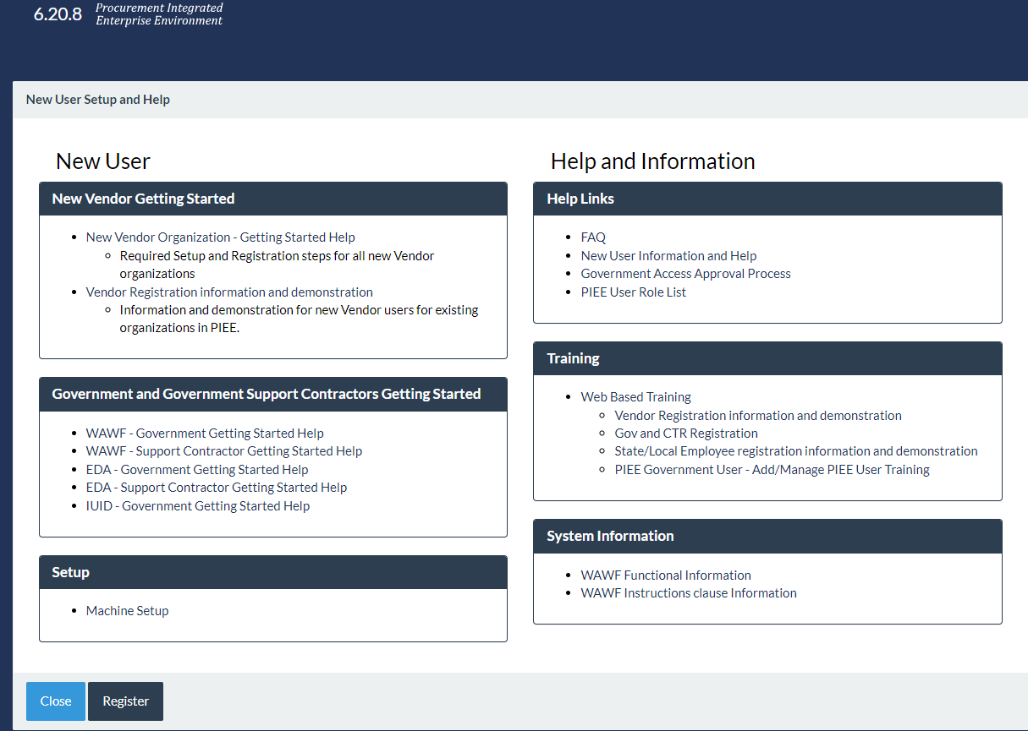
New to PIEE? Get Started with PIEE; click on Register

Slide 8
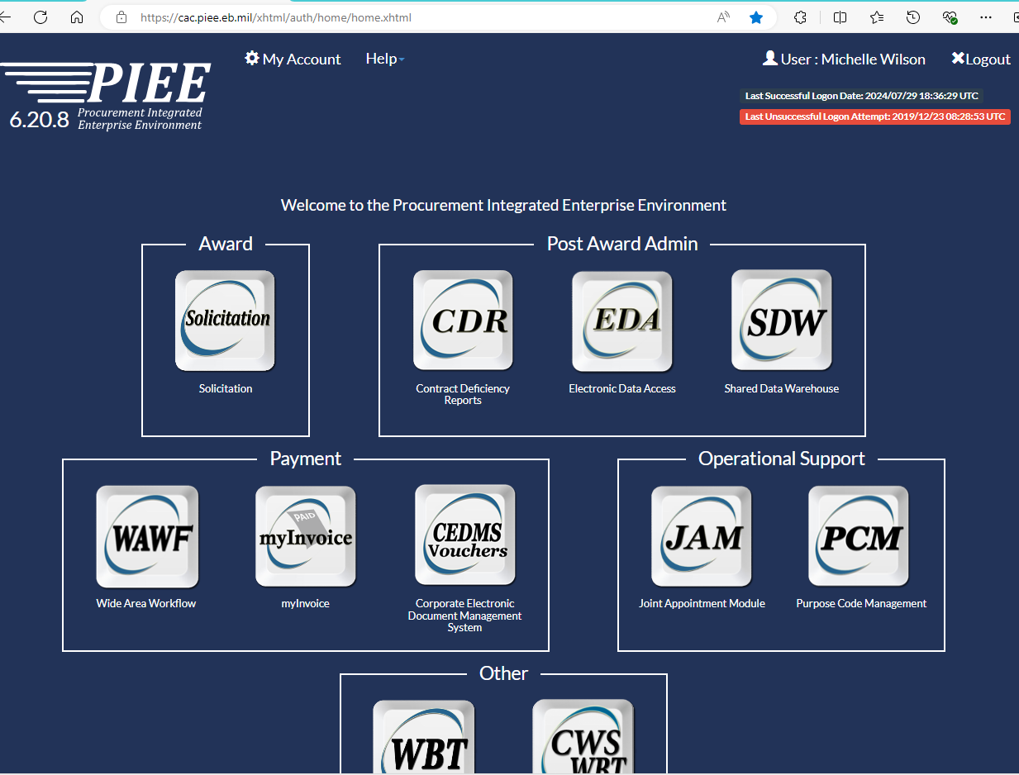
MyInvoice
On this screen you can select:
myInvoice where you can check the status of your invoice.
Click myInvoice.

Slide 9
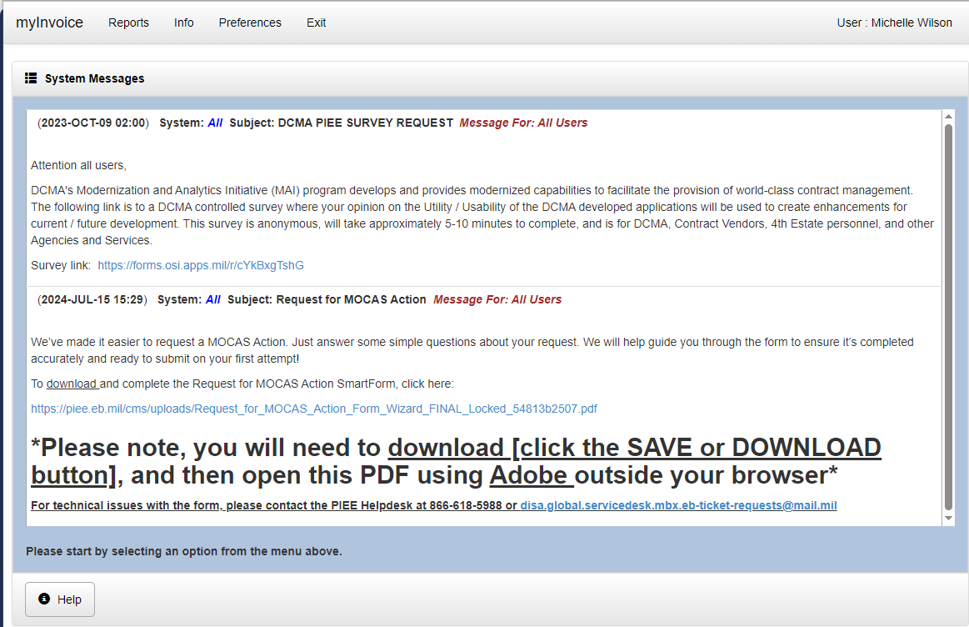
MyInvoice
Select Reports at the top of the screen
Notes:
Click Reports

Slide 10
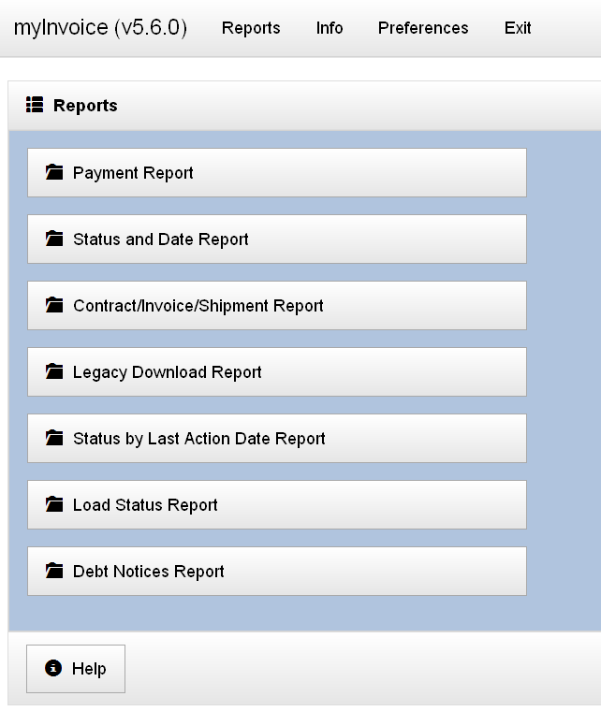
Reports – Vendor
iRAPT Vendor Role
There are 7 reports for each entity.
The vendors have a Legacy Download report not accessible by Government.
Each report has different search criteria and different summary data in the search results.

Slide 11
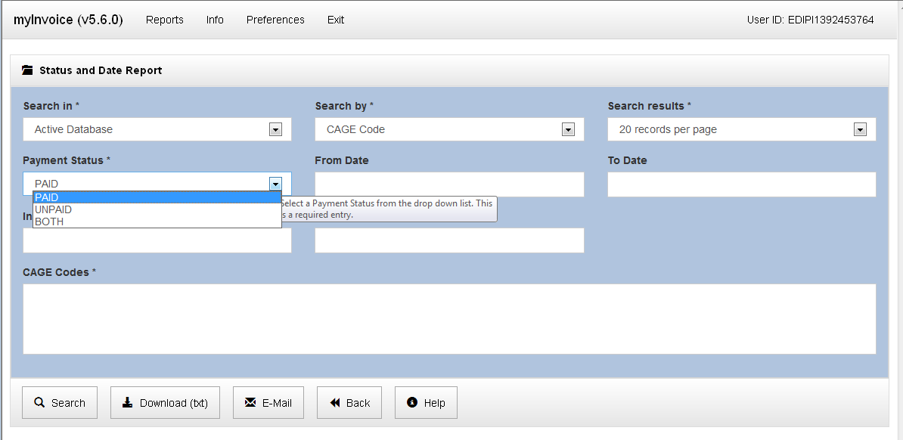
MyInvoice - Report
Input CAGE Code Here, Click on Search
Once you select the report, you can Search by CAGE or DUNS.
For Government users, they must type in the CAGE or DUNS in the large CAGE Codes box.
For contractors/vendors; you CAGE or DUNS should appear in this large box area.
You can Search or Download from this screen.
Click Help for assistance with items shown on each screen.
* Indicates the required fields.

Slide 12
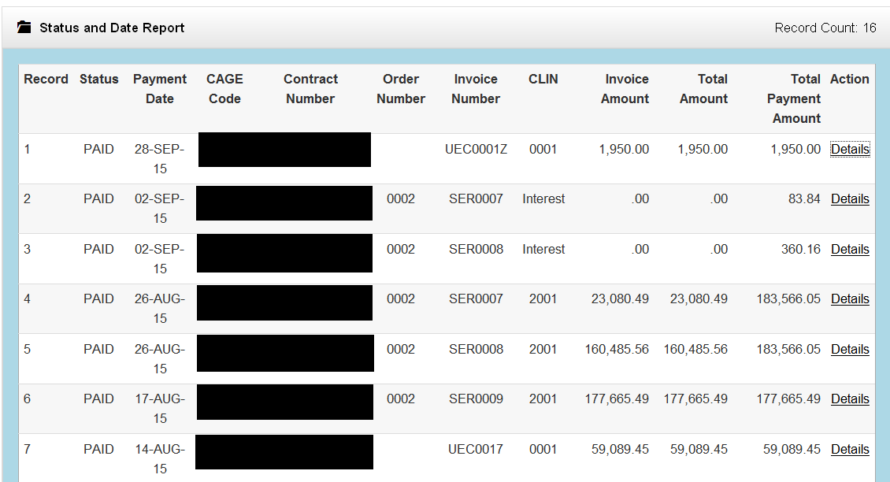
MyInvoice
Notes:
This is the summary report.
If you search, the number of records under that CAGE or DUNS will appear. Depending on the way you set-up your system, usually 20 records will appear on each screen.

Slide 13
Detail Report
Available with all reports except for Load Status and Debt Notices
Contains all data associated with the invoice
Displayed by clicking the “Details” link for the invoice on the summary results page
Contains Reason and Remarks reference codes, Interest Reason reference codes & Adjustment Reason reference codes
  Complete reference code lists are available under the Info menu

Slide 14
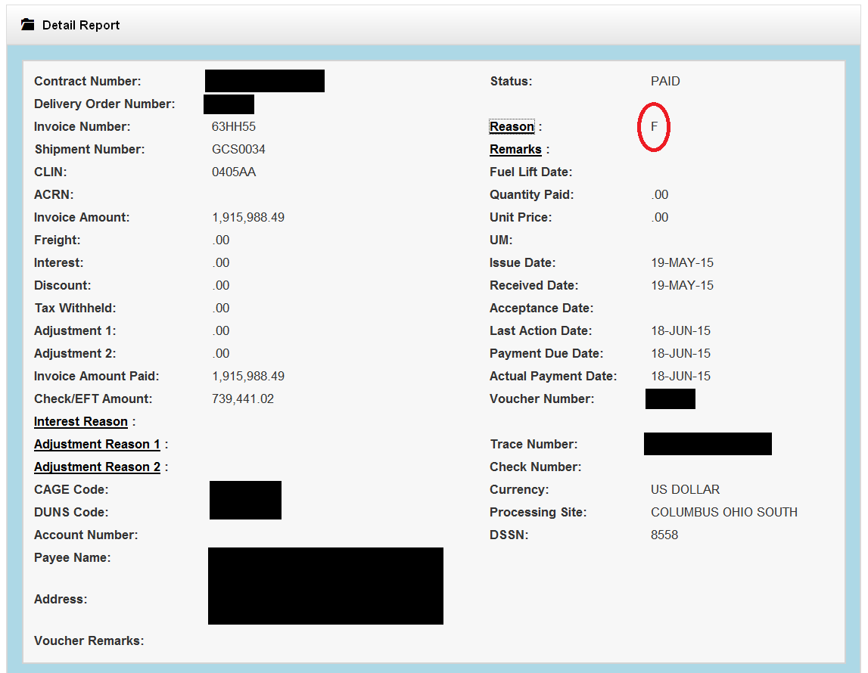
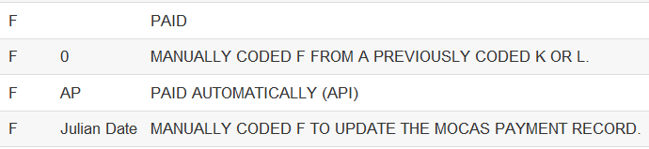
Detail report
Notes:
This is the detail report, when you click on DETAILS on the right side.

Slide 15
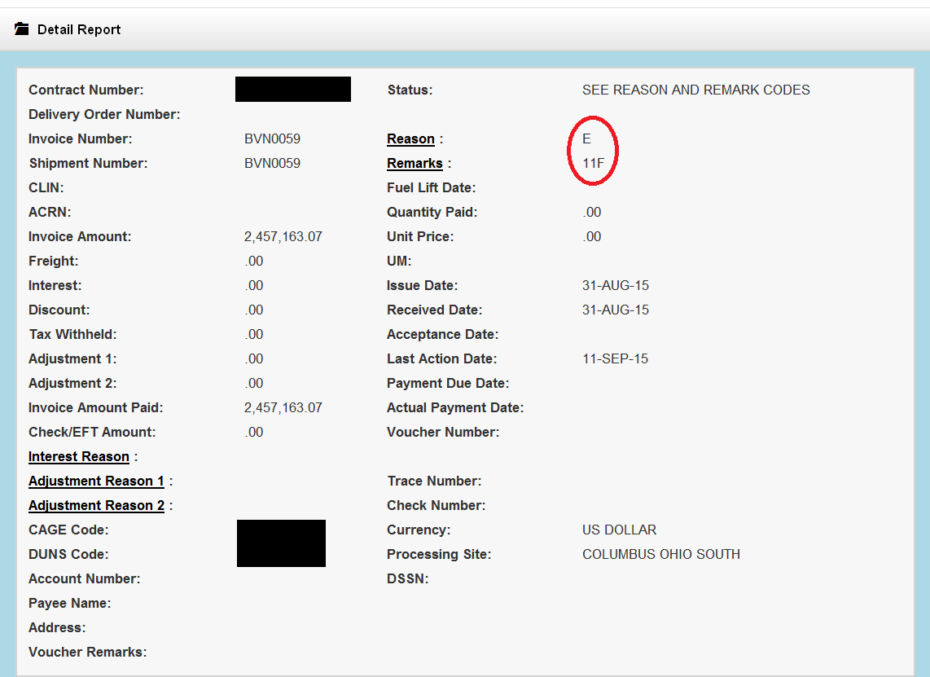
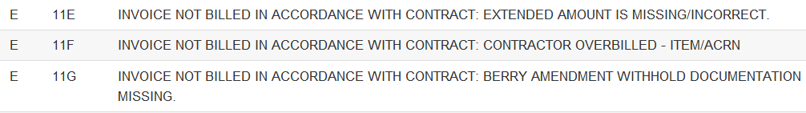
Detail report

Slide 16
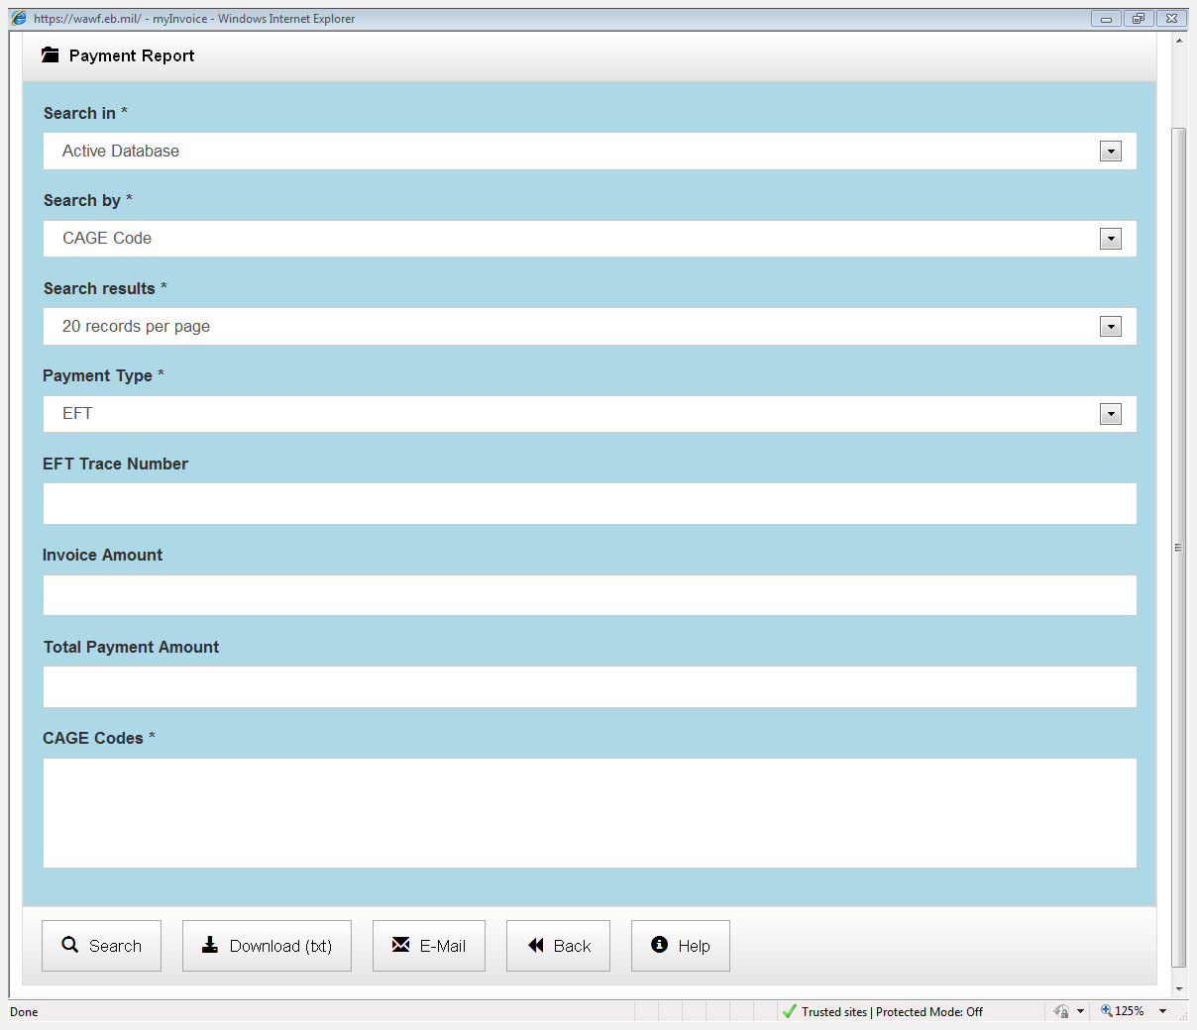
Email Assistance
Email assistance is available with myInvoice reports
  Exclusion applies to the following reports:
  Load Status Report
  Debt Notices Report
Please use AskDFAS for the following Sites:
  Cleveland
  Columbus
  Indianapolis
Notes:
Columbus, Cleveland & Indianapolis now use AskDFAS for email inquiries. This link should still work for Rome Inquiries

Slide 17
Downloading Results
Reports are downloadable as a comma delimited text file
Downloading report data is a resource intensive process that relies on both server side and client side resources
Download process begins when the user clicks the “Download (txt)” button
  A “Downloading” popup displays instructions not to close the window before the download is complete
  Be patient when downloading files, especially large spreadsheets
  Link on how to view a txt file in excel format:
  https://www.youtube.com/watch?v=sbYi85oRH5o&spfreload=10
Notes:
Many factors can influence the performance of the download, server side resource allocation, client side security settings and network latency are the primary candidates.
Please be patient as you download your files, especially if you are downloading large (3000 records or more) Excel spreadsheets. Excel spreadsheets are created “in memory” on the server and require no template files as opposed to the legacy myInvoice application.

Slide 18
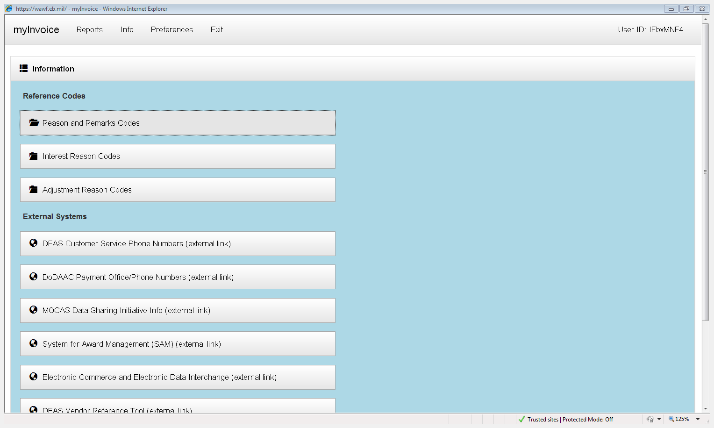
Information Menu
myInvoice allows users to view reference code tables and access external web sites
Use this page to view reference codes or navigate to external websites.

Slide 19
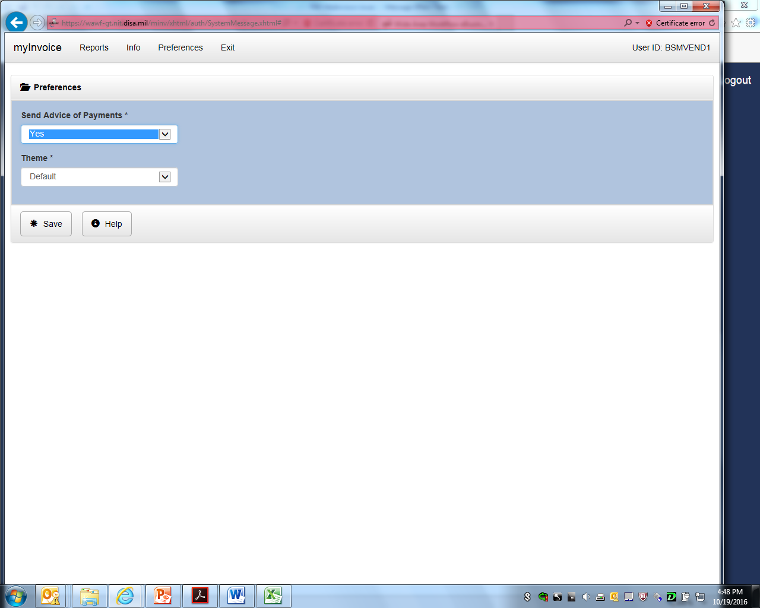
Preferences Menu
myInvoice allows users to select a color Theme and select if they want to receive Advice of Payments

Slide 20
Paid Information Retention Timeframes
Paid invoice data may be available for up to 120 days after payment.
System | Timeframe
EBS | 30 DAYS**
GFEBS | 90 DAYS
MOCAS | 90 DAYS
CAPS | 120 DAYS
DAI | 120 DAYS
DEAMS | 120 DAYS
FABS | 120 DAYS
IAPS | 120 DAYS
NAVY ERP | 120 DAYS
STARS ONE-PAY | 120 DAYS
SAVES | 120 DAYS
Notes:
**EBS info will store for 30 days with 2 exceptions:
If it is a final payment on a line item and there are other line items open, the line item paid in full will only be provided to myInvoice for a couple of days
If the contract is paid in full with the available funds for that particular day, it will only be provided to myInvoice for a couple of days

Slide 21
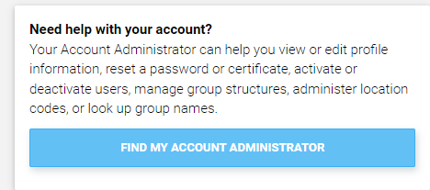
MyInvoice - assistance
For assistance with your invoice status or with requests to take action on your invoice please contact DFAS Customer Service:
  by submitting your request via AskDFAS at the following link:
https://corpweb1.dfas.mil/askDFAS/custMain.action?mid=5300
  by calling a telephone number listed at the following link:
https://www.dfas.mil/dfas/AskDFAS/DoDAAC.html
To find your paying DODAAC please refer to the 6 character alphanumeric code in
on your contract in the box labeled: PAYMENT WILL BE MADE BY CODE.
For assistance with accessing myInvoice, please contact your Group Administrator (GAM). To find your GAM please use the following link on the PIEE log in screen:

Slide 22
MyInvoice - assistance
If you need further technical assistance please contact Ogden Help Desk
Tel: 801-605-7095; 866-618-5988
Fax: 801-605-7453.
Email: disa.global.servicedesk.mbx.eb-ticket-requests@mail.mil
You can review a video titled Checking Invoice Status in MyInvoice on YouTube: https://www.youtube.com/watch?v=sbYi85oRH5o
For training materials please access Web Based Training (WBT): https://pieetraining.eb.mil/wbt/
If you observe irregularities in myInvoice performance, please send an email to DFAS ESS Business Integration Services dfas.dscc.jjh.mbx.cco-esolutions-myinvoice@mail.mil

